Slide 1
BUSINESS INTELLIGENCE + INTELLIGENT SYSTEMS AND AGENTS + COGNITIVE SCIENCES
Prof. dr. Matjaž Gams
MPŠ

Slide 2
INTELLIGENT SYSTEMS AND ROBOTICS INTELIGENTNI SISTEMI IN ROBOTIKA
Intelligent Systems and Robotics (ISR) are dealing with advanced information sciences and technologies including intelligent systems, ambient intelligence, business intelligence, evolutionary computation, cognitive sciences, humanoid robotics, computer vision, controlling robots and systems. These are key information society technologies enabling knowledge-based society. Evolutionary algorithms Humanoid and service robotics
Intelligent systems and agents
Intelligent robot control
Cognitive sciences
Business intelligence
Robot vision Modern control systems seminar work + oral exam

Slide 3
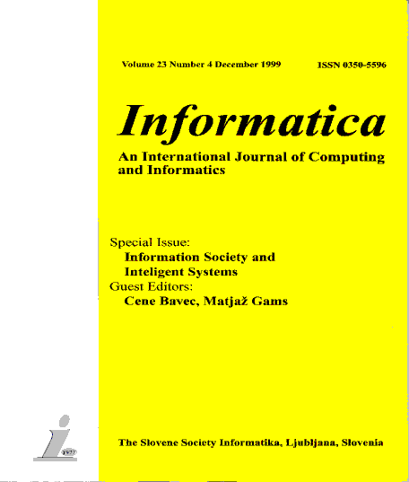
SOCIETIES
ACM Slovenia, SLAIS, DKZ, IAS, Informatika
Dictionary: Wikipedia style – enter new terms
http://dis-slovarcek.ijs.si/ (računalniški slovarček) 12.000 gesel
Informatica
PhD reports 2 pages
Among best quoted Slovenian journals in Google, Scopus etc.
JSI department growth – E9, E8, E3 …Our now 35 members
Co-founder of ACM Slo, SLAIS, DKZ, IAS
Best application: employment agent first over 90% of jobs
Best awards: best Slovenian innovation, best cooperation ..

Slide 4
DEFINITIONS OF INTELLIGENCE
Intelligence has been defined in different ways, including the abilities for abstract thought, understanding, communication, reasoning, learning, planning, emotional intelligence and problem solving.
Intelligence is most widely studied in humans, but has also been observed in animals and plants.
Artificial intelligence is the intelligence of machines or the simulation of intelligence in machines.
Numerous definitions of and hypotheses about intelligence have been proposed since before the twentieth century, with no consensus reached by scholars.

Slide 5
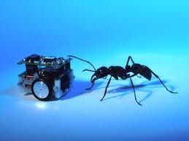
DEFINITIONS OF INTELLIGENCE
Is there a universal definition of intelligence?
Natural intelligence (humans, animals, plants),
Artificial intelligence,
Engineering intelligence.

Slide 6
DEFINITION OF ARTIFICIAL INTELLIGENCE
Wikipedia: Artificial intelligence (AI) is the intelligence of machines and the branch of computer science that aims to create it.
AI textbooks define the field as "the study and design of intelligent agents"[2] where an intelligent agent is a system that perceives its environment and takes actions that maximize its chances of success.
[3] John McCarthy, who coined the term in 1956,[4] defines it as "the science and engineering of making intelligent machines."[5]
(Artificial intelligence has been the subject of breathtaking optimism, has suffered stunning setbacks and is today an essential part of the technology industry, computer science and IS.)

Slide 7
ARTIFICIAL INTELLIGENCE
Russell and Norvig ARTIFICIAL INTELLIGENCE: A Modern Approach

Slide 8
DEFINITION OF INTELLIGENT SYSTEMS
Intelligent system is a system that learns during its existence.
It senses its environment and learns, for each situation, which action permits it to reach its objectives.
It continually acts, mentally and externally, and by acting reaches its objectives.
To reach its objective it has to select its response. A simple way to select a response is to select one that was favorable in a similar previous situation.

Slide 9
PROPERTIES OF INTELLIGENT SYSTEMS
Learning
Flexibility
Adaptation
Explanation
Discovery

Slide 10
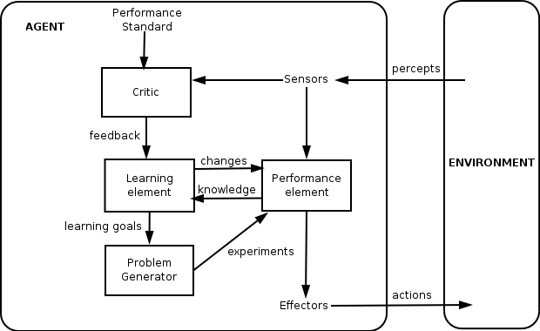
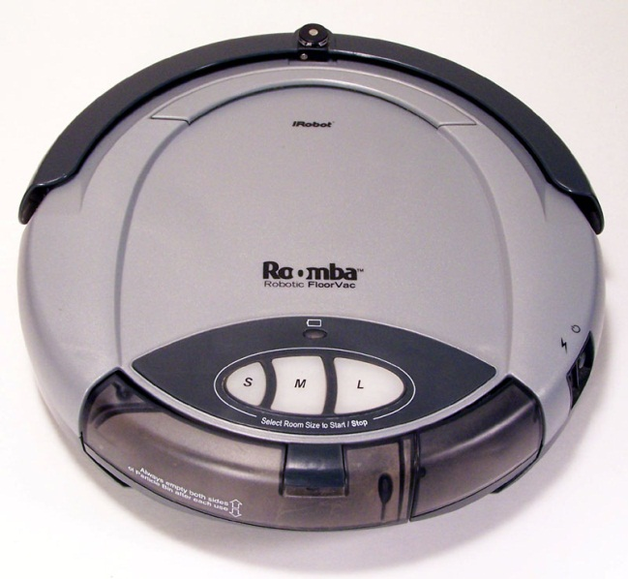
DEFINITION OF INTELLIGENCE
Definition: An intelligent entity is capable of learning. What learns is intelligent.
An intelligent entity is an intelligent system.
Engineering definition: More advanced than current classical solutions (may not learn).
According to Wikipedia: A thermostat is an intelligent agent.
Our definition: an intelligent agent learns.
An intelligent agent without learning is just an agent.

Slide 11
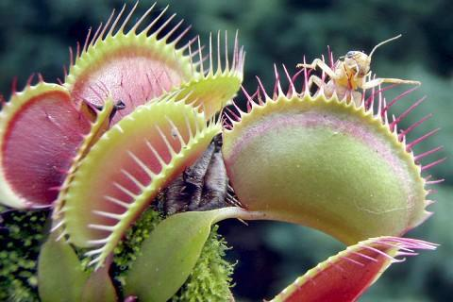
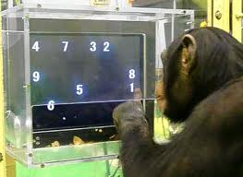
NATURAL INTELLIGENCE
Humans, animals, plants?
Are viruses intelligent?
All beings are!
Different levels of intelligence.
Sort dogs by intelligence.
Do animals really think?
Tools (birds, apes)
Joy, empathy, greed (apes, orkas, elephants, pigs)
Are animals getting smarter?
(humans + aliens?) (interactions with humans, wash food, crash walnuts)
Notes:
muholovka

Slide 12
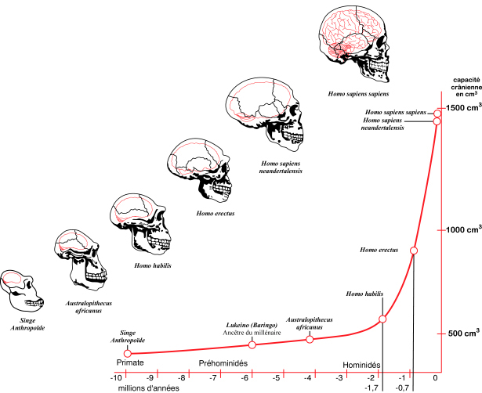
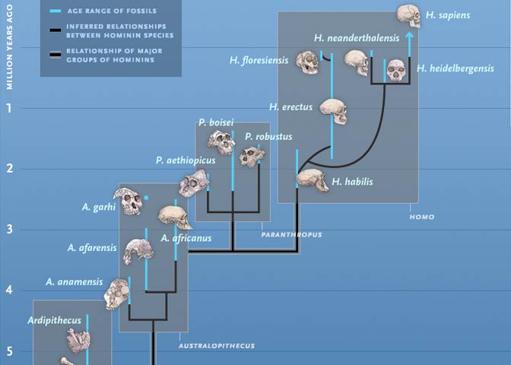
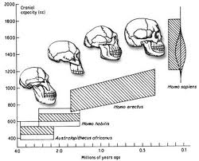
HUMAN INTELLIGENCE
Intelligence = better predictions, better reaction. More energy consumption – 25%.
Sexual attraction? Anthropological principle.
Tool evolution?

Slide 13
Dwarf humans
Scientists have discovered a tiny species of ancient human that lived 18,000 years ago on an isolated island east of the Java Sea -- a prehistoric hunter in a "lost world" of giant lizards and miniature elephants.
These "little people" stood about three feet tall (1 m) and had heads the size of grapefruit. They coexisted with modern humans for thousands of years yet appear to be more closely akin to a long-extinct human ancestor.
Prebivalci okoliških vasi pripovedujejo zgodbe o teh „malih ljudeh“, ki so živeli v pečinah. Ženske so metale prsi čez rame. Ker so jim kradli otroke, so se njihovi predniki enkrat razjezili in jih požgali.

Slide 14
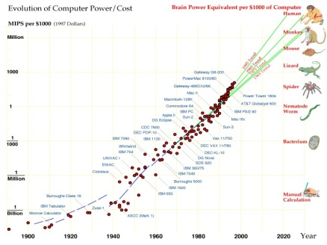
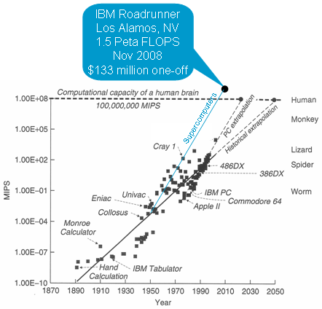
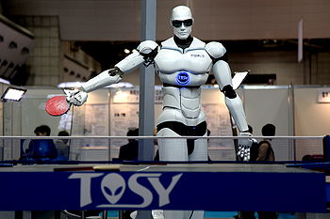
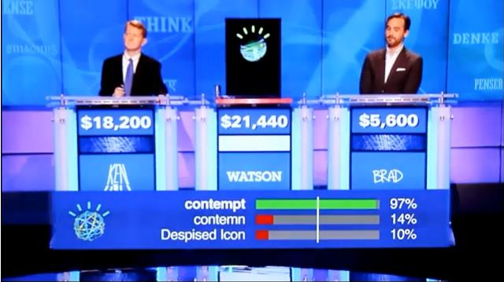
COMPUTERS
Chess, JEOPARDY …

Slide 15
HUMAN INTELLIGENCE VS. COMPUTERS
Moč procesiranja
Računalniki
Ljudje
Different speed, different life span
Čas

Slide 16
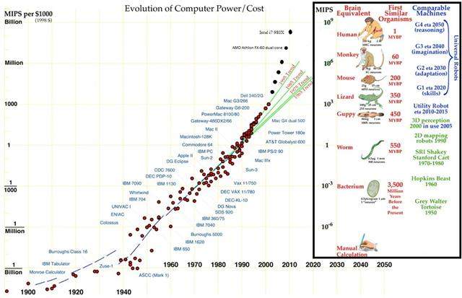
HUMAN INTELLIGENCE VS. COMPUTERS

Slide 17
d
HUMAN INTELLIGENCE AND COMPUTERS
Flynn
Ljudje + Računalniki = Informacijska družba
Moč procesiranja
Računalniki
Ljudje
Compuers are tools for enhancing our mental capabilities
Čas

Slide 18
HUMAN INTELLIGENCE AND COMPUTERS
Ljudje + Računalniki = Informacijska družba
Moč procesiranja
Kurtzweil
Računalniki
Ljudje
Čas

Slide 19
Human-level intelligence
Unknown barrier

Slide 20
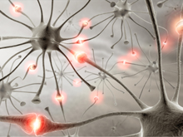
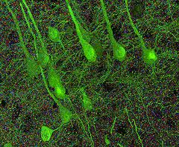
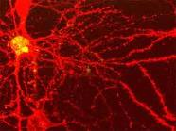
NEURON
Connected to 10.000 each, a switch? Stanford 2010: … the brain’s overall complexity is almost beyond belief, said Smith. “One synapse, by itself, is more like a microprocessor —with both memory-storage and information-processing elements — than a mere on/off switch. In fact, one synapse may contain on the order of 1,000 molecular-scale switches. A single human brain has more switches than all the computers and routers and Internet connections on Earth,” he said.
…neuroscientists uncovered strong evidence that neurons also communicate with each other through weak electric fields. The study, published in the journal Nature Neuroscience, by Dr Costas Anastassiou (Caltech), explains how every time an electrical impulse races down the branch of a neuron, a tiny electric field surrounds that cell ..

Slide 21
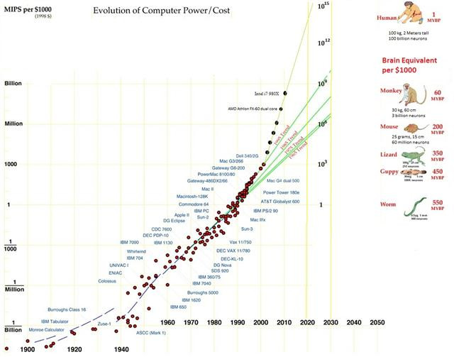
HUMAN INTELLIGENCE VS. COMPUTERS

Slide 22
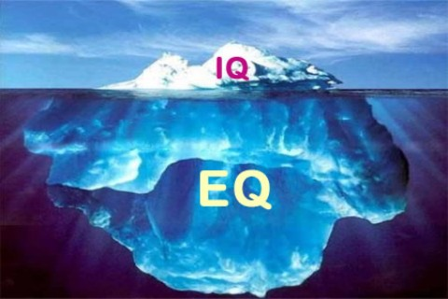
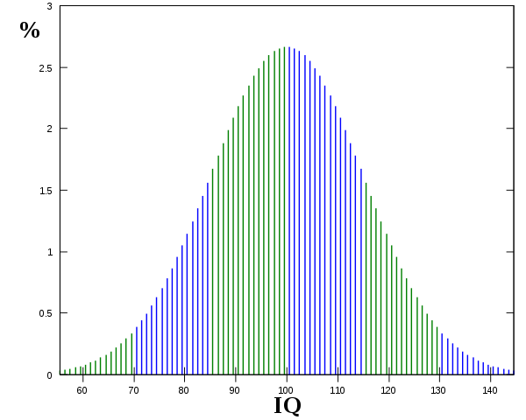
HUMAN INTELLIGENCE
10-30 types of intelligence: general, symbolic, emotional, abstract, motion, visual, speech, read-write, music …
Emotional intelligence (EI) is a skill or ability in the case of the trait EI model, a self-perceived ability to identify, assess, and control the emotions of oneself, of others, and of groups. Various models and definitions have been proposed of which the ability and trait EI models are the most widely accepted in the scientific literature. Criticisms have centered on whether the construct is a real intelligence and whether it has incremental validity over IQ and the Big Five personality dimensions.
Flynnov effect / smarter people have less children
IQ tests of different kinds: specific, integral … Advanced

Slide 23
HUMAN INTELLIGENCE
IQ is the best single predictor of success at job. People with higher IQ have higher title, status, income, live longer and healthier. And vice versa.
(W: individuals with low IQs are more likely to be divorced, have a child out of marriage, be incarcerated, and need long-term welfare support).
What is this – a political lecture?? This is too sensible?
The world is not as it seems! (commercial, political, popular, semi-popular, scientific)
Science, facts, empirical verification, platonism Engineers: Science should deal with relevant issues. What is your opinion?

Slide 24
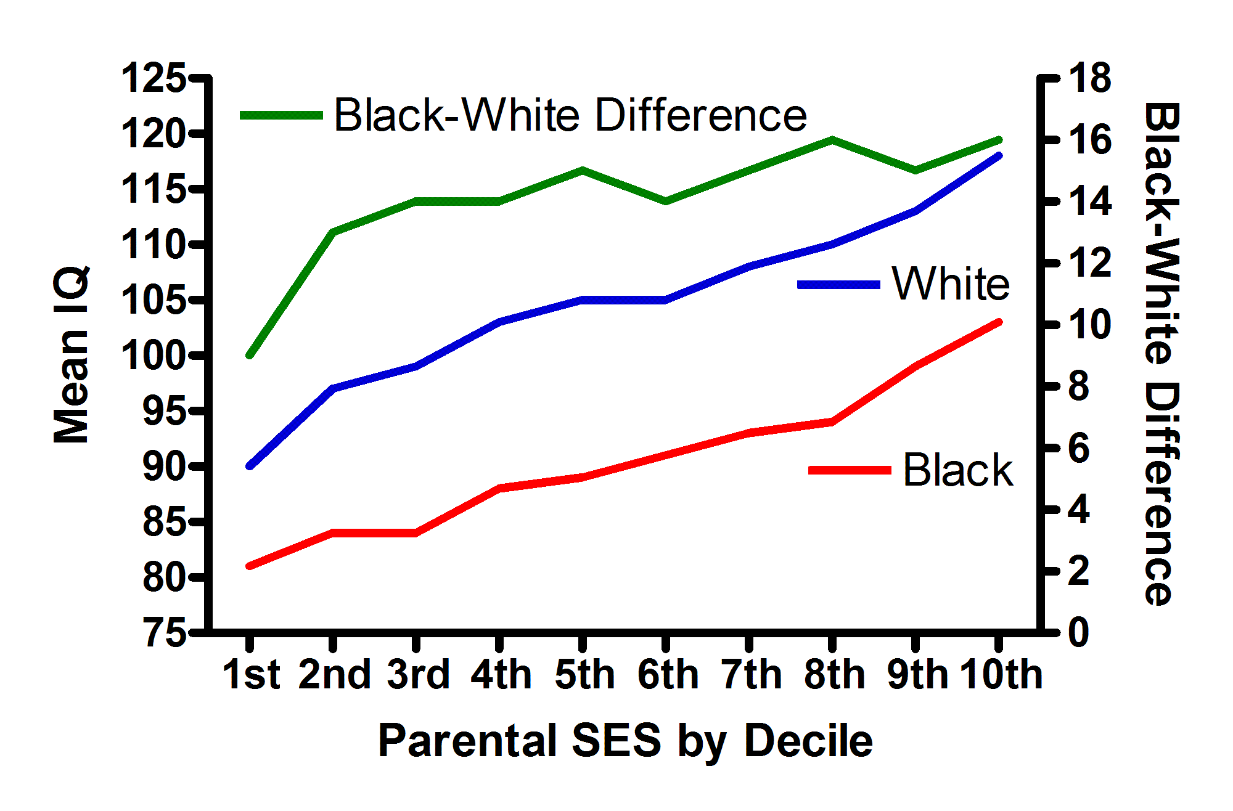
HUMAN INTELLIGENCE

Slide 25
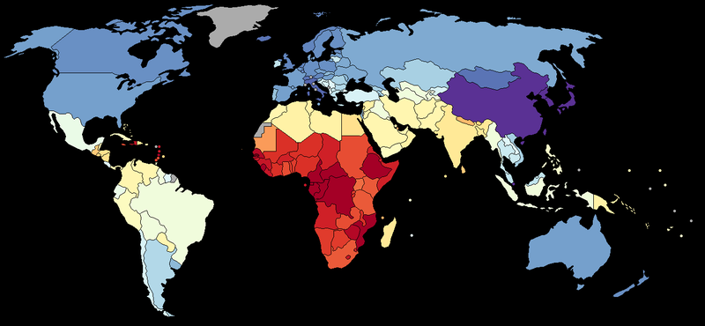
HUMAN INTELLIGENCE
DISTRIBUTIONS: big/small, M/W, religious, use of browser … no major difference! Sobotna priloga 12.3.2011 Resetiranje v 23 tezah

Slide 26
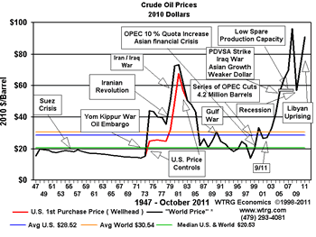
USING INTELLIGENCE FOR PREDICTIONS AND ANALYSES
Can we use intelligent systems to influence our lives?
Example: oil price predictions
Max production in 10-20 years
Jumps up and down
No reliable short-term predictions possible.
Can we predict better?
GAMS, Matjaž. "Inteligentno" napovedovanje cen nafte : umetna inteligenca in inteligentni sistemi. Delo (Ljubl.), 2.9.2004, str. 18, Znanost. [COBISS.SI-ID 18432295]

Slide 27
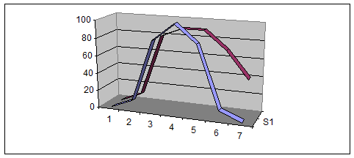
We can predict future! The end of cheap oil – on general it will be more expensive Another prediction/interpretation: Peak oil is one of the real causes of our crisis (or is it neoliberalism and lack of governmental control) Practical consequences of the prediction: What heating (cofund alternative), which insulation? Waste separation?? What do you conclude about future progress from these assertions?

Slide 28
DEMOGRAPAHY - Fertility
World (Pearce)
Stable fertility 2.1 (developed) – 2.3 (world)
1950 fertility 5 – 6
1970 3.9
2000 2.8
2007 2.6 (Pearce)
Now 2.5 (National Geographic)
Brasilia (National Geographic)
1960 1970 1980 1990 2000 2009
6.3 5.8 4.4 2.7 2.4 1.9
Two major factors: woman empowerment, soap operas (sex in the city)

Slide 29
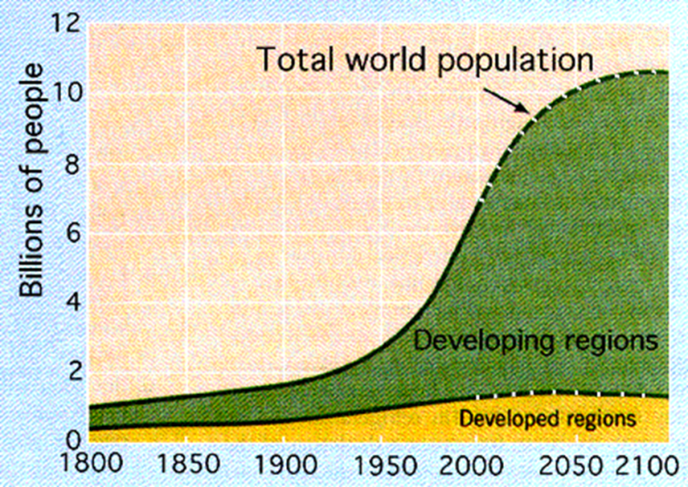
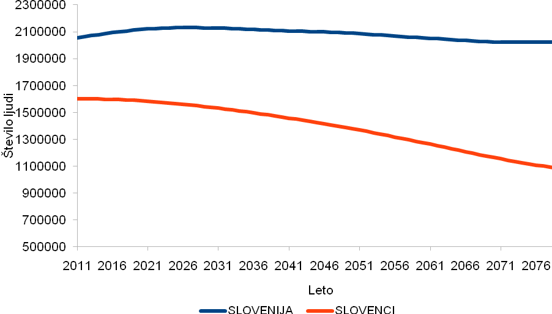
DEMOGRAPHY World: With fertility 2.5 and falling, growth to 10, then ??; fast growth only in sub-Saharan Africa Europe: European demographic winter – relations similar to Slovenia Slovenia: Seemingly no problems in Slovenia due to high migration, in reality very low fertility leading to extinction of Slovenians Predictions: World populations will grow fast due to time delay – but is close to sustainable fertility Slovenia: extinction or not depends on our information and will Pension reform is urgent and is caused by longer living +9 hours in 24
Starost
Moški

Slide 30
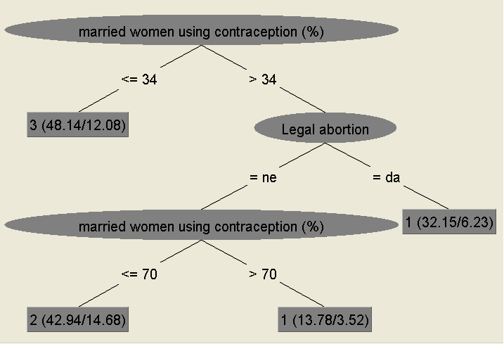
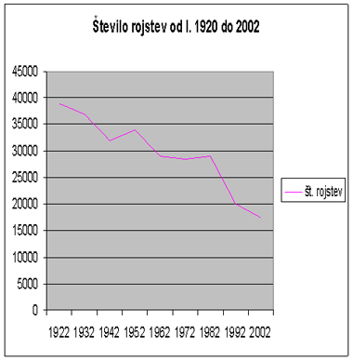
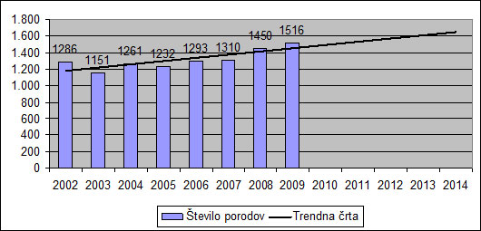
DEMOGRAPHY
Lots of studies with ML methods
Predictions by intelligent methods
Practical consequences:
Better informed population
Enhance family status
Fertility growth
Urgency of pension reform

Slide 31
WHICH TREE TO TRUST?
Given data and the constructed tree,
Can it be trusted? Can it be verified?
Can it be improved?
Different statistical measures (kappa …)
Design trees under different parameters
Adapt some algorithmic approach
IMPACT OF HIGH-LEVEL KNOWLEDGE ON ECONOMIC WELFARE THROUGH INTERACTIVE DATA MINING, Applied Artificial Intelligence: An International Journal
Volume 25, Issue 4, 2011, Pages 267 - 291
Authors: Vedrana Vidulinª; Matja Gamsª
Science: funds (comp., pat., women, technicians, govern.)
Education: mobility and % of students, several more

Slide 32
DISCUSSION
What is intelligence?
What is science/ scientific?
A superior level of understanding
Knowledge and intelligence enable better predictions and performance

